Slide 1


Mr. Hem Raj dhakal ime group
Entrepreneurship
Presented by: Sujan shrestha (np000611)

Slide 2
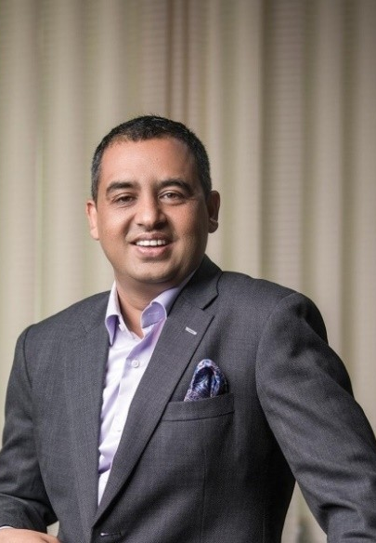
Background of hem raj dhakal
An entrepreneur who is well known for co-founding the IME conglomerate and was instrumental in the establishment of the remittance industry in the nation.
Born on November 24, 1975, in Baglung, Nepal, and achieved his schooling while staying in Baglung before coming to capital for further studies.
A Master of Business Studies (MBS) from Tribhuvan University, an Entrepreneurial Master's Program (EMP) from the Massachusetts Institute of Technology (MIT) and attended the London Business School (LBS) Growth Forum
Completed the Owner/President Management Program (OPM) at Harvard Business School.
Serves as President of the Nepal Malaysia Chamber of Commerce and Industry, a member of the National Council of the Confederation of Nepalese Industries (CNI), and an executive committee member of the Nepal India Chamber of Commerce and Industry (NICCI)

Slide 3

Background of ime group
The IME conglomerate is formed up of various companies that operate in different sectors such as remittance, travels and tourism, trading, technology, tourism, vehicles, insurance, and many others.
IME Group's key values include innovation, customer satisfaction, and social responsibility. Its story began with IME Remit, a pioneering enterprise in the Nepalese remittance market that thoroughly became a trusted and familiar name for tons of Nepalese around the world looking for secure and efficient money transferring service.
2000+ Direct Employments Generated
5 Million Households Benefited
40000+ Indirect Employments Generated

Slide 4
Source of Idea for the existence of IME Group
Chandra Prasad Dhakal who began his career as a banker at Rastriya Banijya Bank decided to take up a cargo business in 1992 after sensing opportunity in it. In 2001, he along with his brother Hem Raj Dhakal, ventured into the remittance business by establishing International Money Express (IME) in Nepal and Malaysia.
Mr. Hem Raj Dhakal's visionary aim helped to transform the firm ran by family into a corporate business, with his team members now aligning with the company’s vision and slogan, Encouraging Spirit, which serves as a driving force for the team.

Slide 5
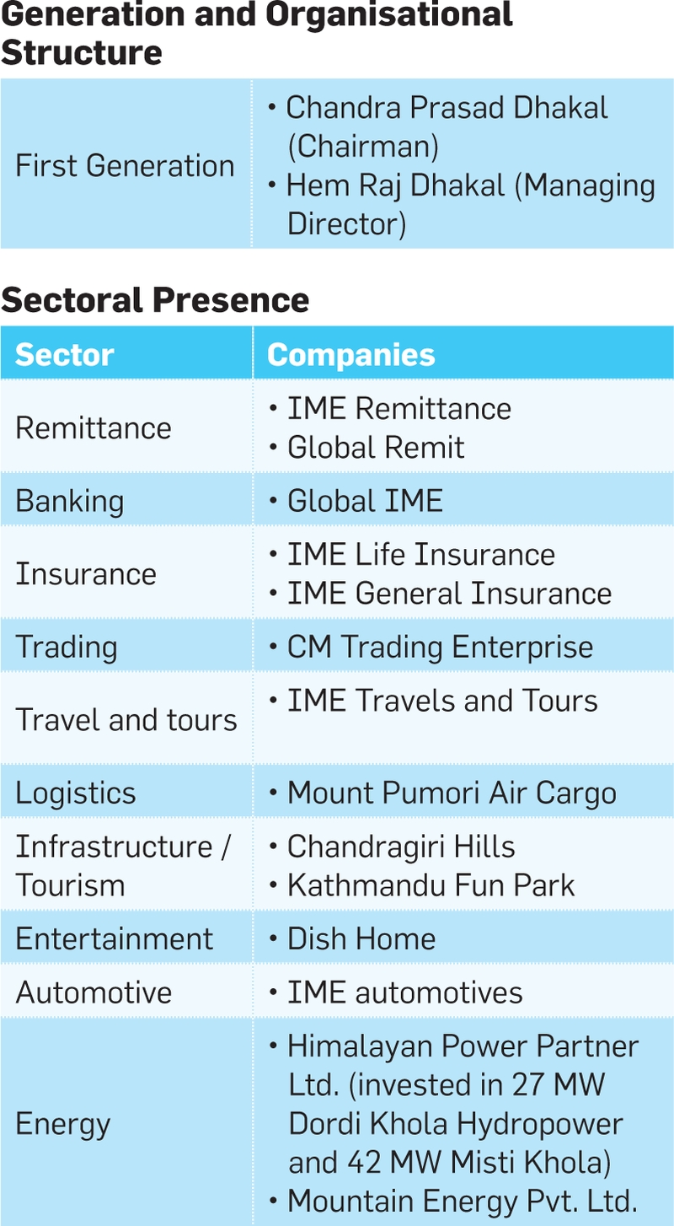
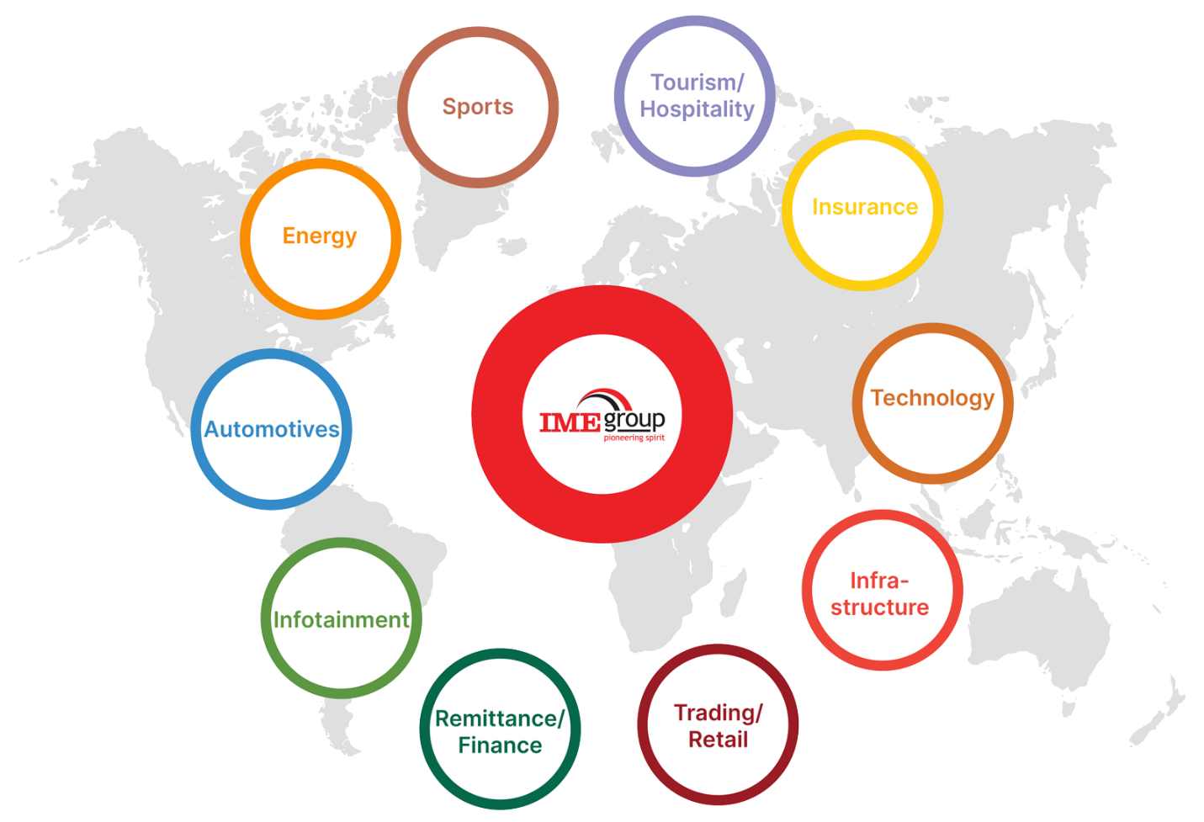
Opportunities Exploited by IME Group

Slide 6
Resources Mr. Hem Raj Dhakal used to start and then grow the business.
Financial Capital: Leveraged significant financial investments to fund initial operations and expansion, enabling the establishment of subsidiaries and strategic investments to seize opportunities for growth.
Human Capital: Assembled a skilled team across various fields including finance, technology, marketing, and operations, recognizing the importance of talent in executing the conglomerate's growth strategy.
Industry Knowledge and Expertise: Utilized deep understanding of the Nepalese commercial landscape to develop strategic plans, navigate market dynamics, and capitalize on emerging opportunities, ensuring IME Group stayed ahead of competitors.
Networking and Relationships: Leveraged a broad network of connections within the business community to form strategic partnerships, acquire capital, and expand into new sectors, providing valuable insights, cooperation opportunities, and support for growth.
Technology & Infrastructure: Invested significantly in modern infrastructure and IT solutions to enhance operational efficiency, service delivery, and market competitiveness, utilizing cutting-edge technology to streamline workflows and provide innovative solutions to customers.

Slide 7
Challenges Faced Along the way
Regulatory and Compliance Difficulties: Negotiating regulatory frameworks and compliance standards, especially in finance and remittance sectors, requiring meticulous navigation and strategic planning.
Competition, Market Dynamics: Managing competition from domestic and international rivals, staying abreast of market changes, and differentiating products/services to attract and retain clients.
Technological Disruptions: Adapting to rapid technological advancements, integrating new technologies while ensuring data security and integrity.
Operational Efficiency and Scalability: Maintaining efficiency and scalability amidst diversified operations, including managing complex supply chains and ensuring smooth coordination across sub-branches.
Risk Management and Resilience: Addressing various risks such as economic volatility, currency fluctuations, and natural calamities through robust risk management strategies to ensure long-term viability.

Slide 8
Business strategy approach undertaken by the selected entrepreneur
Diversification & Expansion: IME Group diversified across sectors for risk management and growth, expanding beyond remittances into banking, technology, healthcare, and more.
Innovation & Adaptability: Prioritized technological innovation and adaptability to market changes, enhancing operational efficiency and customer experience.
Customer-Centric Approach: Focus on customer happiness and loyalty, offering tailored products/services and maintaining strong client relationships.
Strategic Partnerships: Utilized partnerships with domestic/international organizations to access new markets and capitalize on synergies for growth.
Corporate Social Responsibility (CSR): Integrated CSR into business plan via IME Foundation, investing in education, healthcare, and community development, enhancing brand reputation and stakeholder relations.

Slide 9
Thank you

